Slide 1
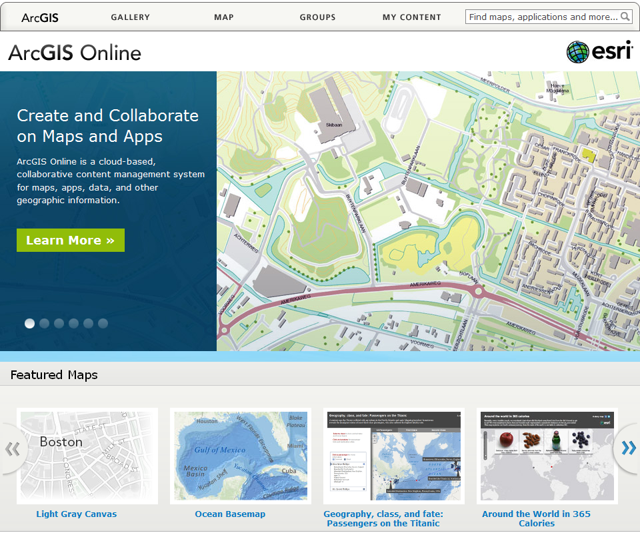
ArcGIS Online for Watershed Groups
Ben Reinhart
Clinton County Soil & Water Conservation District

Slide 2
Pros & Cons
+
-
Able to access files straight from web (e.g.HUC, STORET, 303/305 Reports, TMDLs, etc.)
Wide variety of base maps
Very easy to share and has ability to create “interactive” slides
Editing display characteristics is relatively easy (thumbnails?)
Query tools/Address Locator
Extensive resource materials available
Some may prefer to do the majority of edits and imports in ArcMap
Photos need to be hosted
Need to determine which viewer is preferred
1,000 Feature Limit on imported layers
Limited labeling features
Cannot import layer or raster files

Slide 3
Interactive Presentations
http://www.arcgis.com/explorer/?present=8e06c324fe0f4bd5a1c39e5487c4f8f8

Slide 4
Next Steps
Privacy Issues
Data Management
Explore Dashboard Gadgets (i.e. charts, graphs, gauges, etc.)
Research Forms & Blogs
Points of Interest
Water Trails
Incorporate into website

Slide 5
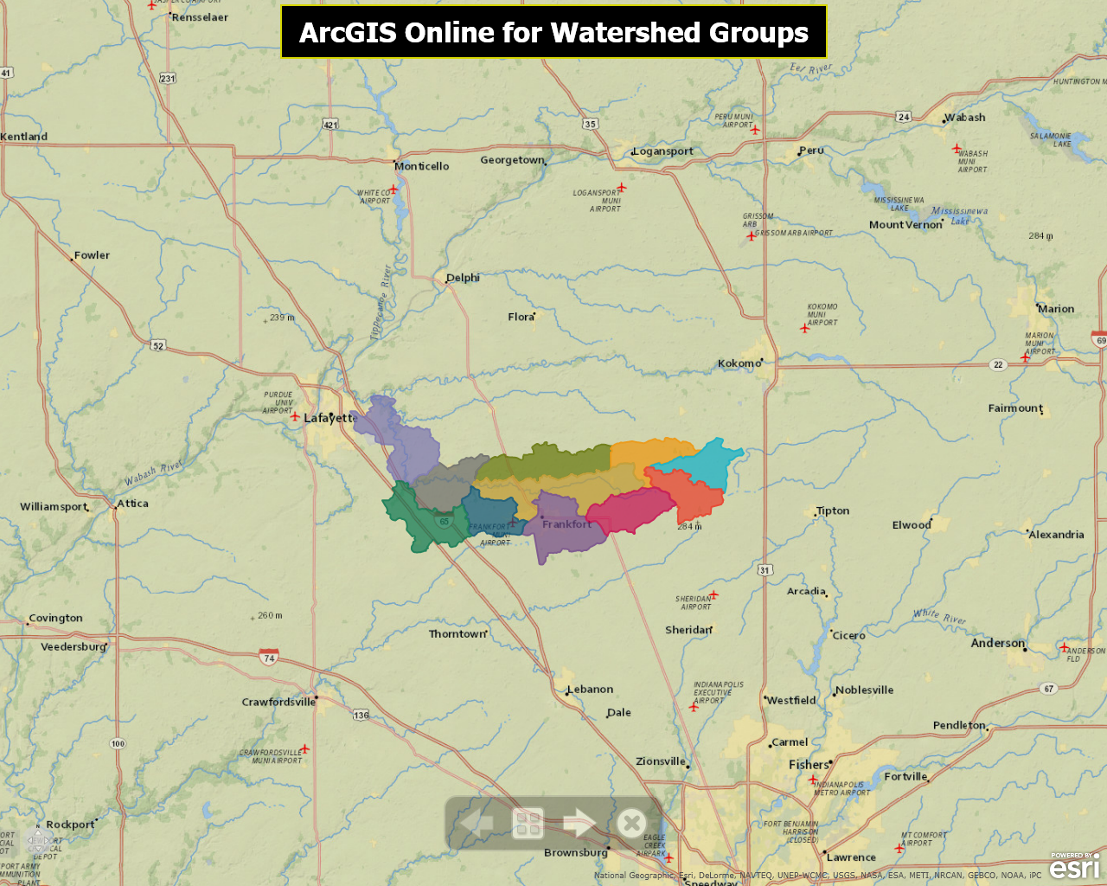

Slide 6
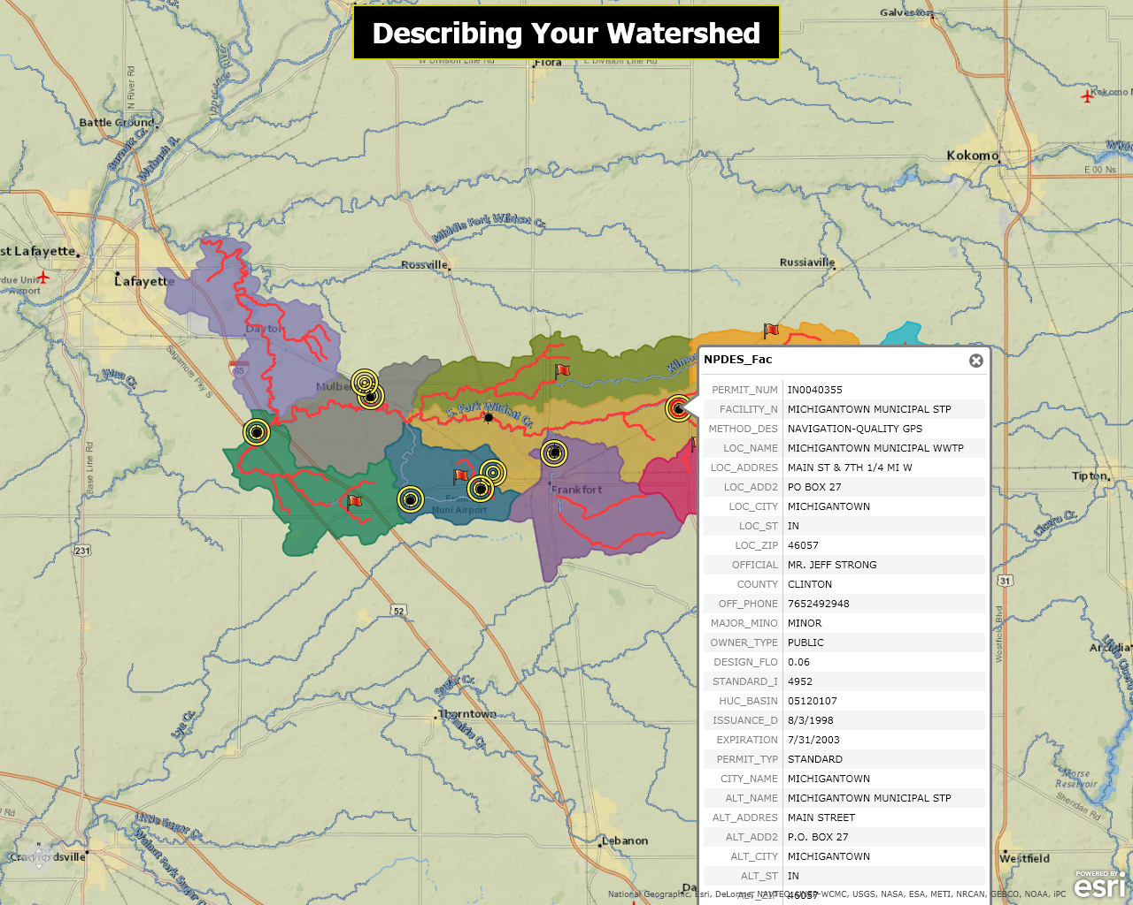

Slide 7
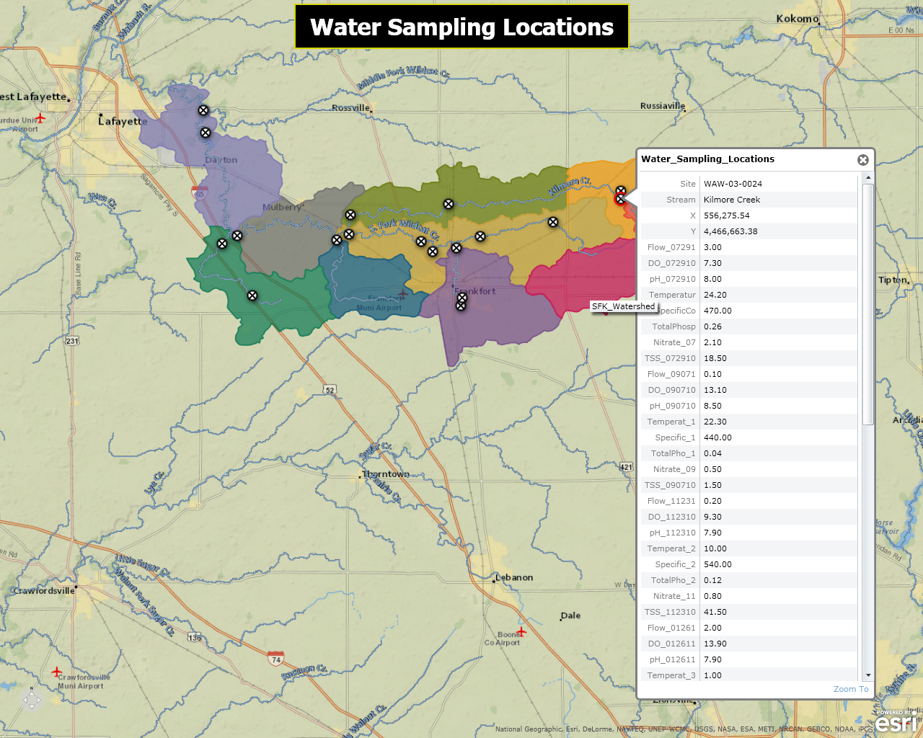

Slide 8
